Slide 1
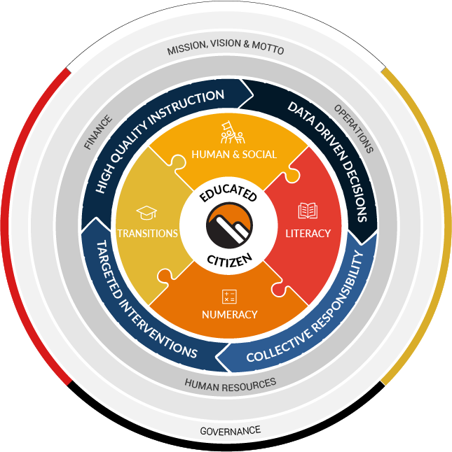
Strategic Plan 2021-2025
Our conceptual framework is designed to communicate the big ideas that we believe about our school district in a visual, holistic fashion.
Features of the framework include:
The framework is wrapped in First Peoples Principles of Learning (FPPL), using the colours of the cardinal directions of the medicine wheel: White, Yellow, Red and Black. The layers of ‘Mission, Vision and Motto’ as well as Governance are positioned at the outer edges of the framework, representing the important role of keeping our organization moving in the same direction as outlined by our Vision:
~Syós:ys lets’e th’ále, lets’emó:t~
(See EYE yees, LETS – a - thala, LETS – a - mot)
~One heart, one mind, working together for a common purpose.~
A Statement About Learning
Learning must be engaging, relevant and meaningful, grounded in inclusive practices and First Peoples Principles of Learning, and committed to the growth of future-oriented citizens.
Insert School Name Here
HIGH QUALITY INSTRUCTION
DATA DRIVEN DECISIONS
Mindfulness- integrating this through all of our work
Innovative, inclusive and research based instruction and assessment practices support the well-being of all learners and their readiness to be inspired and engaged in life-long learning.
The intentional collection and analysis of meaningful evidence ensures that actions and decisions directly support the success of all learners.
TARGETED INTERVENTIONS
COLLECTIVE RESPONSIBILITY
Timely and targeted supports are the cornerstone in creating a culture of equity and belonging where all learners thrive and reach their potential.
Common core values and shared responsibility for student success promotes deep collaboration and commitment to growth as educated citizens.

Slide 2
LITERACY
Goal
We are dedicated to ensuring that students are proficient in foundational literacy skills and increase their abilities, confidence and willingness to engage with language to acquire, construct and communicate in meaningful ways from Early Learning Years (pre-K) through to Grade 12.
We understand, plan and deliver instruction using competency-based curriculum (curricular competencies and content).
We utilize competency-based assessments to assess student progress pre-K to grade 12.
We implement data driven, timely and targeted instructional interventions for students.
School Actions
1. Lit Circle Reading – include a choice of novels
2. Read Daily- D.E.A.R
3. Social Studies and Humanities: focus on literacy skills
Assessment for literacy skills in SS and English
4.Use of Paradigm for consolidation of information about students
5. ACT bi-annual assessments
6. One School One Book- promoting literacy in homes
7. One Teacher One Book- every teacher reads the same book to their class
8. Literacy Committee
9. Targeted Interventions for those students in need of Tier 2 Interventions from LA and RT
10. After School Literacy Collab with Hollie Redden
Actionable Items
Vertical Integration of Curriculum
Break down of competencies – working as a vertical team to align what is being dome at each grade ?
Vertical team meeting- include the high school?
Grade vs. Department Meetings- need more cohesion
Target Basic Skills at each grade
ELL Needs more focus
School Measures
ACT
School Wide Write
Paradigm Consolidates information for teachers
District Measures
FSA 4 (Reading / Writing)
FSA 7 (Reading / Writing)
Literacy 10 and 12
PM Benchmarks (running records)
ACT (Assessment of Comprehension and Thinking)
Notes:
Vertical Integration of cirriculum and who does what- getting together to create a "roadmap" of competiencies covered
Department meetings
Paradigm and transition notes about all of our students being done fully
Literacy and Numeracy- district measures- worked with grade levels in each grades what did each assessment show us - what data is and how it is used- using the data as a group to see what people are doing well and using it in our classrooms
Students who do not have case managers- using the MDI survey how students are doing socially and emotionally in the survey- over 50% are getting less than 5 hours of sleep- many do not feel like they have an adult connection at school
Using wellness surveys throughout the year with students
Circle check ins and temperature checks for students at the start of class and is something that lends itself well to middle school class structures
Mentorship program- students check in with eachother throughout the year - checkinIg service hours or office refferals to see who is using that time at the school and may benefit from an adult connection
Targeting basic skills needs- lack of grit in our students and lack the ability to do work well and dig in- how do we build up grit and work on something until it is well done.
Integrating literacy and numeracy in tech
Social and emotional is harder to measure - how do these students move through high school from us to them and using a post class survey that would find how kids have attached to the teachers
Are we working through the cirriculum? Working through the growth mindset model and changing assessment has changed
How we assess mental health and mental well being- how do we assess them? We can' send all of them to the office, what do we do and how do we teach while trying to work on the mental health of kids in the classroom. How do we address the mental health tools and lack there of ...because it is very difficult to get to the cirriculum when that is what we are dealing with
Having a mental health day that we could work with students and learn skills
Having an afternoon where Grade 8's etc work on a common subkect or theme
Social and Emotional wellness is the bigegst theme that we need to address as a staff with our kids

Slide 3
NUMERACY
Goal
We are dedicated to ensuring that all students become proficient in numeracy skills that allow them to create, apply and conceptualize mathematics in real world situations from Early Learning Years (pre-K) through to Grade 12.
We understand, plan and deliver instruction using competency-based curriculum (curricular competencies and content).
We utilize competency-based assessments to assess student progress pre-K to grade 12.
We implement data driven, timely and targeted instructional interventions for students.
School Actions
1. Use of BC Curriculum to guide our instruction, plus vertical articulation with our collogues
2. Assessments such as the SNAP train students for a particular style of learning – does not assess all competencies
More use of competency rubrics would be helpful
3. Student Support Time, Homework Club and individual one on one instruction opportunities to guide students who require interventions
Evidence of those in need of these interventions comes from our daily formative assessments
4. Targeted Interventions for those students in need of Tier 2 Interventions from LA and RT
5. Math Contests
6. After School Math Collab – passionate teachers willing to improve
Actionable Items:
6. Vertical Integration of Curriculum- Katie White Breakdown of Competencies – how do we enable this in a cohesive way across all departments and grades ??? Staff Meeting Time?
7. Vertical Teams Organize Priorities
What do you want students to know
What is important
Target basic skills in numeracy
8. What are ways to meet as math teachers without adding more meetings? – time for vertical alignment of curriculum in staff meetings to set forth a cohesive school plan
School Measures
SNAP-6
FSA-7
SNAP-7
Paradigm Data Consolidation
District Measures
FSA 4
FSA 7
Numeracy 10
SNAP (Student Numeracy Assessment and Practice)

Slide 4
HUMAN AND SOCIAL DEVELOPMENT
Goal
We celebrate diversity, embrace inclusion and foster a sense of belonging to ensure all students thrive. Equity and inclusion are foundational to learning and leading, and are critical to success, wellbeing and fulfillment.
School Actions
Check in’s with students to see how they are doing during class time. Conversations
Be a Kind Human- recognition for those going above and beyond for kindness and thinking of others – students and staff
Post Cards Home Recognizing the importance of letting families know how well their students have been doing when they are recognized by teachers
Paradigm
Transition notes from elementary
Grade to Grade transition notes at VMS
More information needed for all students not just reluctant learners
5. SEL of Teachers included in Meetings that can be carried over into the classroom – Jody Carrignton lessons from the start of the year
6. Core Competency Self Assessments
7. Grade Wide Initiatives: Grade 7 Food Drive, Grade 8’s Fun Day for Grade 6’s
8. School Wide Initiatives: Clothing drives, Cereal Box Challenge
9. Leadership for Students to participate in
10. DOVE Girls
11. WEB
12. Working within Family of Schools partnerships to provide ”At Risk” students with the opportunity to find helping and leadership roles with elementary aged students – Tyson Elementary Partnership
13. Student Services Department: Inclusion Teacher support, counselling support, RT/LA
24. Circle of Courage Framework as the guiding Principle for developing social and emotional needs of the “Whole Child”
Actionable Items
Can Class groupings in September be based off of feedback from Grade 7 teachers ?
Connecting with students in all cohorts?
Vertical Integration of Health Curriculum/ lessons : Growth Mindset, Resiliency, Mental Health
E.g. In Grade 6 we do… In Grade 7 we do…
4. Days of the Month that can be SEL Days
5. SEL of Teachers included in Meetings that can be carried over into the classroom – Jody Carrignton lessons from the start of the year
Connecting with students in all cohorts?
We understand, plan and deliver competency-based curriculum (curricular competencies and content) related to Social Emotional Learning and Mental Health Literacy.
We commit to truth, reconciliation and healing to address the inequity of outcomes for Indigenous learners. We address unconscious bias, systemic discrimination and marginalization to transform district culture.
We provide supports for the well-being of all learners.
School Measures
MDI Survey- Grade 7
Transition Survey Data
Equity Scan
Core Competency Student
Self-Evaluation Review
District Measures
Student Learning Survey grade 4, 7, 10 and 12
EDI (Early Years)
CHEQ (Kindergarten)
MDI (Middle Years)
BCAHS (BC Adolescent Health Survey)
YDI (Secondary Years)

Slide 5
TRANSITIONS
Goal
Students experience pivotal transition points throughout their education, from pre-K to Kindergarten, from grade to grade, school to school, and from school to post-secondary or work situations. We acknowledge our responsibility to support all learners, so they successfully complete their education (pre-K through to Grade 12) with a sense of dignity and purpose, and opportunities to meet their goals.
We target early years learning to ensure students are well supported during their transition to Kindergarten, throughout their elementary years and to middle school.
We utilize developmentally appropriate practices through the Middle Years Pillars (Advisory, Teaming, Collaboration, Exploratory) to foster growth through the adolescent years.
We ensure students find meaningful pathways, throughout secondary school and beyond graduation, including post-secondary, apprenticeship, college and workplace.
School Actions
1.Grade 5 School Tours
2. New Student videos introducing staff and life at VMS
3. Grade 5 Class Visits with Grade 6 Classes – virtual
4. WEB Days for incoming Grade 6’s in the summer
5. LFI: Flipgrid for Myles (6-7 Transition)
6. WEB Support throughout the year for students
7. All data about the student is stored in Paradigm- IEP reports, assessments, SNAP, ACT, attendance, - year to year to ensure a fulsome perspective of student data is collected
Actionable Items:
1.Working with our Family of Schools to identify and support at risk families across grades and schools to ensure that there is a streamlining of support and resources to support the families and students across the schools and grades
2. Staff team building to allow better relationships
3. Capstone Project that teachers guide students through
4. Showcase Day that allows students to showcase their talents and skills
School Measures
Paradigm Data: compilation of all data for student including transition notes from elementary, middle and high school
Elementary Transition Meetings: each year for incoming Grade 6’s – academic/social emotional information
High School Transition Information: information passed to high school – academic/social emotional
District Measures
Grade to Grade Transition Data
5 and 6 Year Completion Rates (Graduation)
Post-Secondary Transition Rates
Attendance Rates

